Slide 1
Mathematics of Cryptography

Slide 2
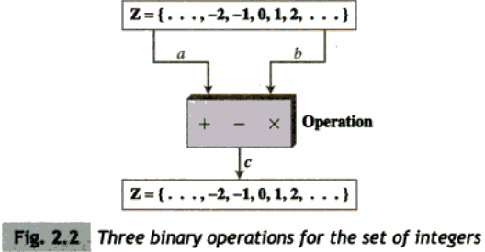
Integer Arithmetic

Slide 3
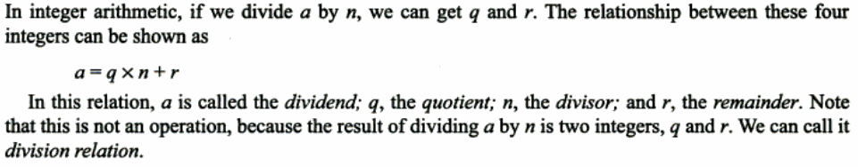

Slide 4
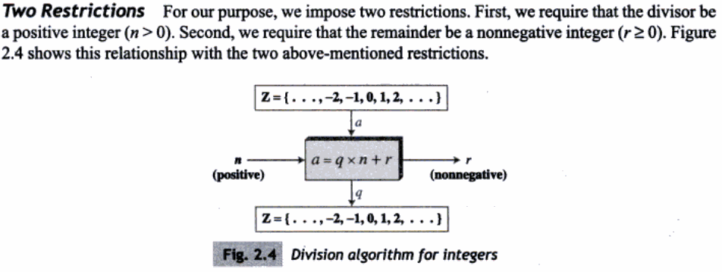

Slide 5
what if a is negative?
a = -160, n = 3 q= -53, r=-1
-160 = -53*3 + (-1)
-160 = -54*3 + (-1+3)

Slide 6
Divisibility
when n successfully divides a, r becomes 0, then
a = q*n
if we are not concerned about q value, then
n|a
if n can’t divide a, then
n x a

Slide 7
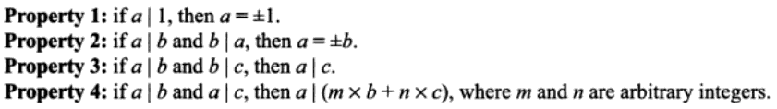

Slide 8
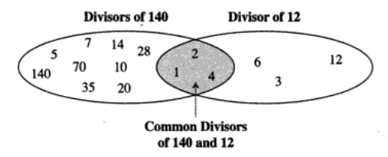

Slide 9
Euclidean Algorithm
It is based on two facts
  gcd(a,0) = a
  gcd(a,b) = gcd(b,r)
function gcd(a, b)
if b = 0
return a
else
return gcd(b, a mod b)

Slide 10
Relatively Prime Numbers
when GCD(a,b) = 1, a and b are said to be relatively prime
{8, 9} {14, 15} {20, 21} {24, 25}
{26, 27} {27, 28} {33, 34}

Slide 11
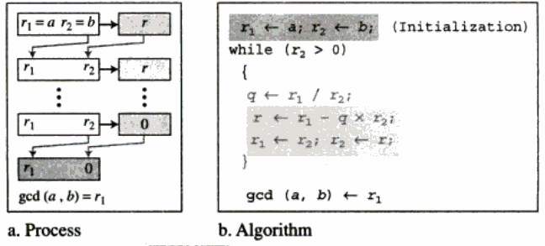
Working of Euclidean Algorithm

Slide 12
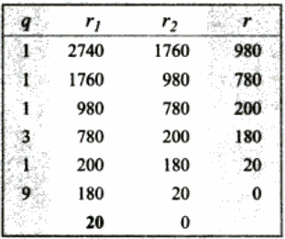
A Working Example

Slide 13
The Extended Euclidean Algorithm
Given two integers a,b we need to find x and y such that
as+bt = GCD(a,b)
In each step of the solution we use 3 sets of variables s,t and r

Slide 14
How it works?
r1 and r2 are initialized to a and b
s1 and s2 are initialized to 1 and 0
t1 and t2 are initialized to 0 and 1
r is the remainder when r1 is divided by r2
the above division results in a quotient ‘q’

Slide 15
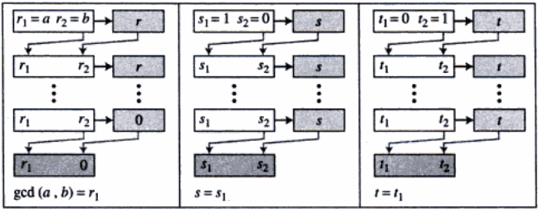

Slide 16
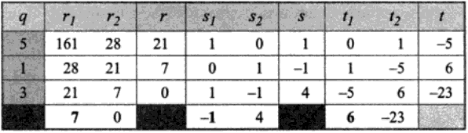
Find s and t such that as+bt = GCD(161,28)

Slide 17
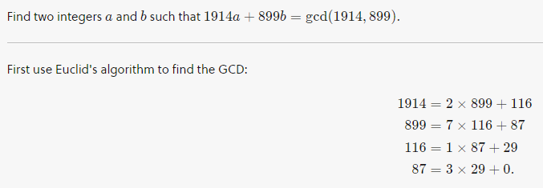
A different way of looking at it...

Slide 18
